Slide 1
Representing the IEDB in OWL
OBI workshop presentation
Vancouver
March 2010

Slide 2

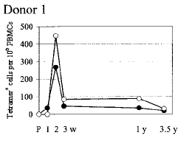
The Immune Epitope Database (IEDB)
Goal: To catalog, organize and make accessible immune epitope information
Epitope discovery contract submission
Literature curation
IEDB www.immuneepitope.org

Slide 3
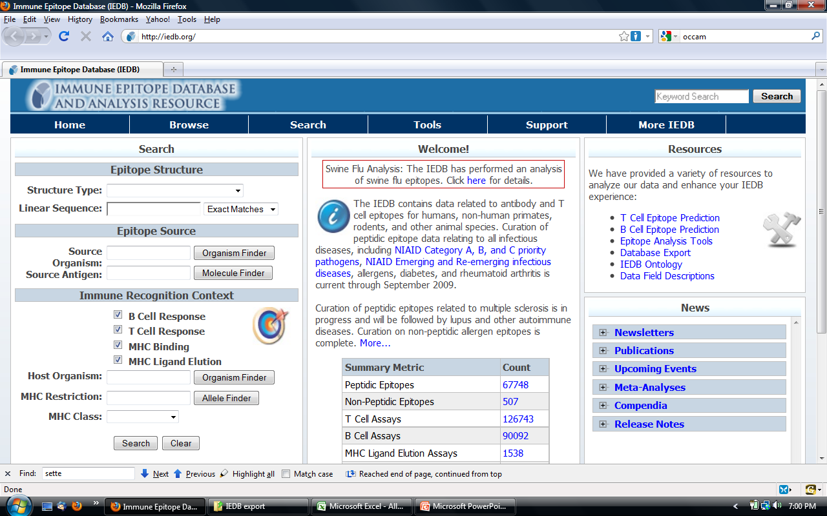

Slide 4
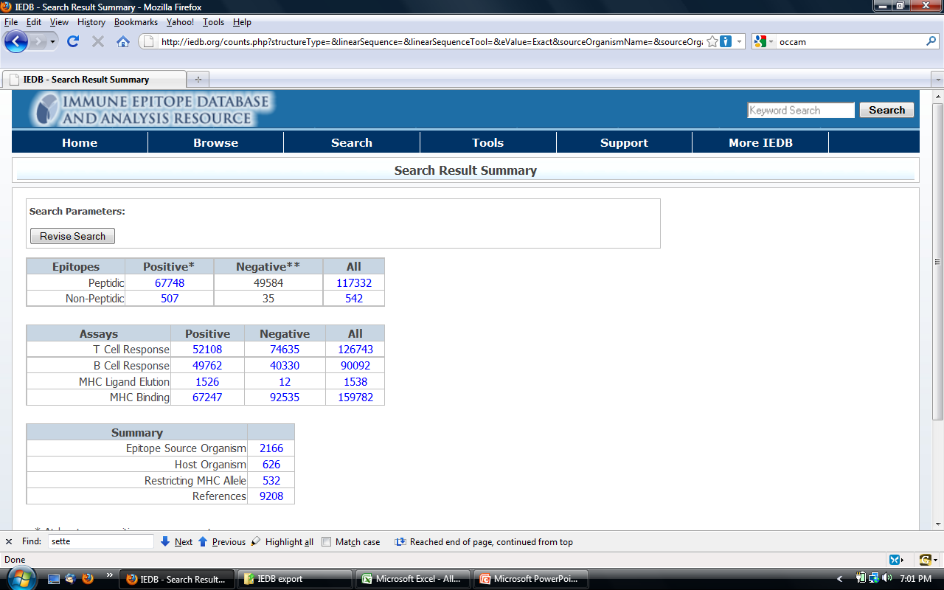

Slide 5
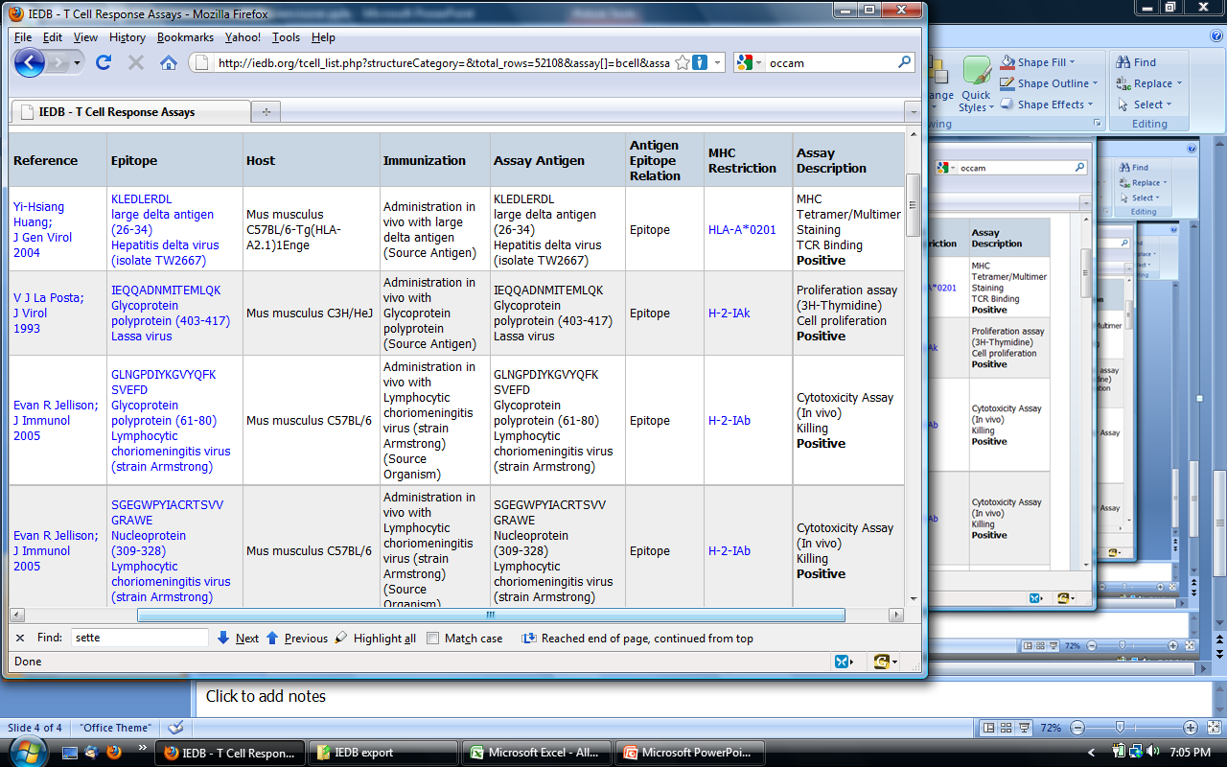

Slide 6
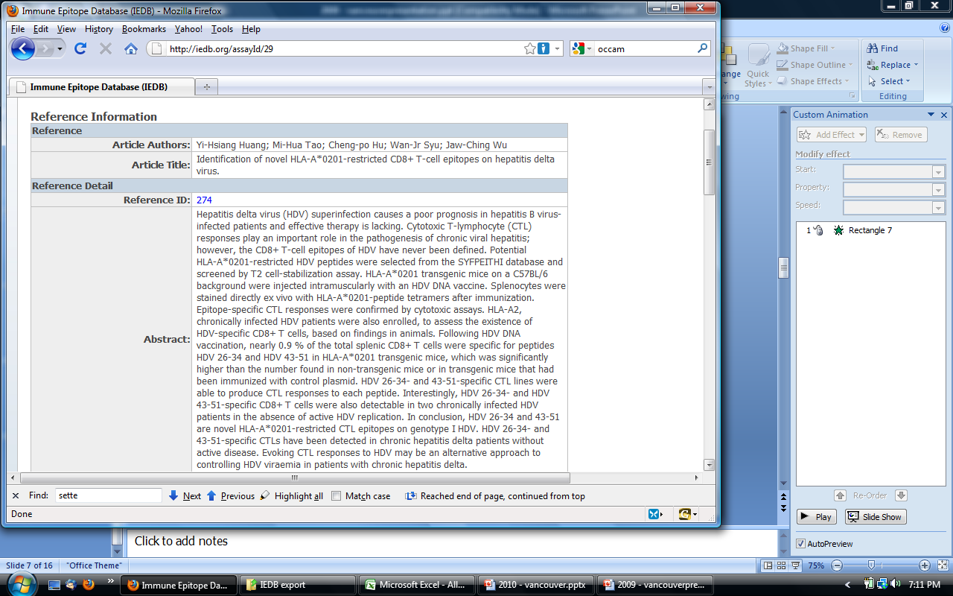

Slide 7
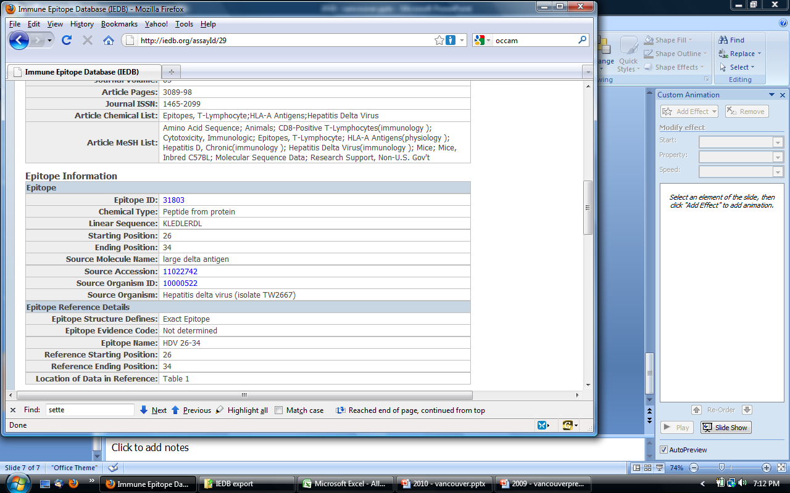

Slide 8
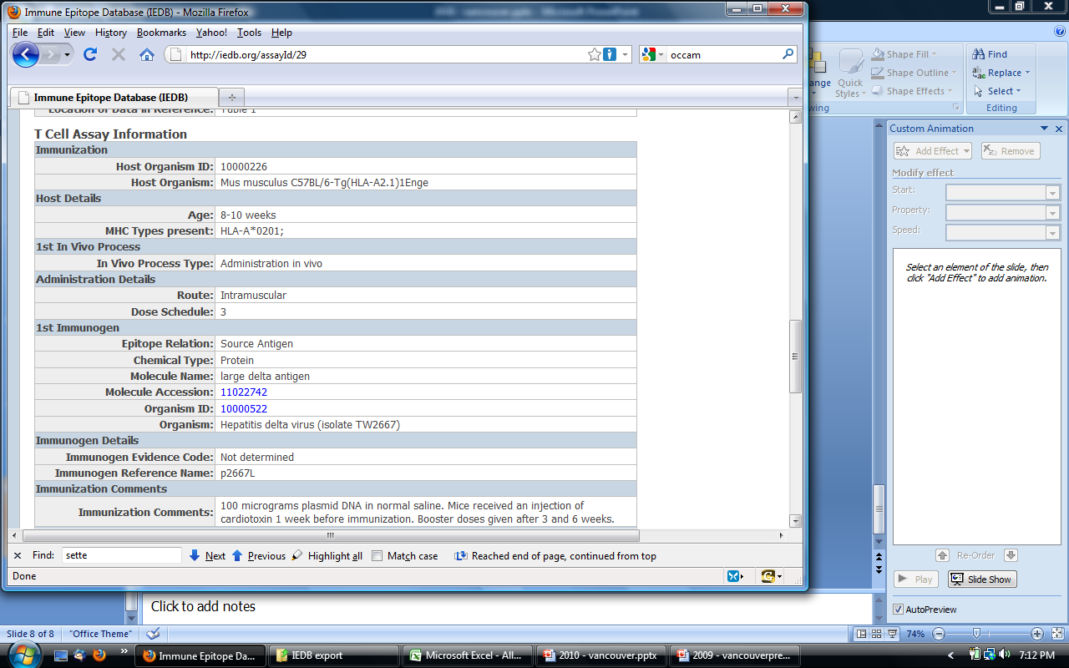

Slide 9
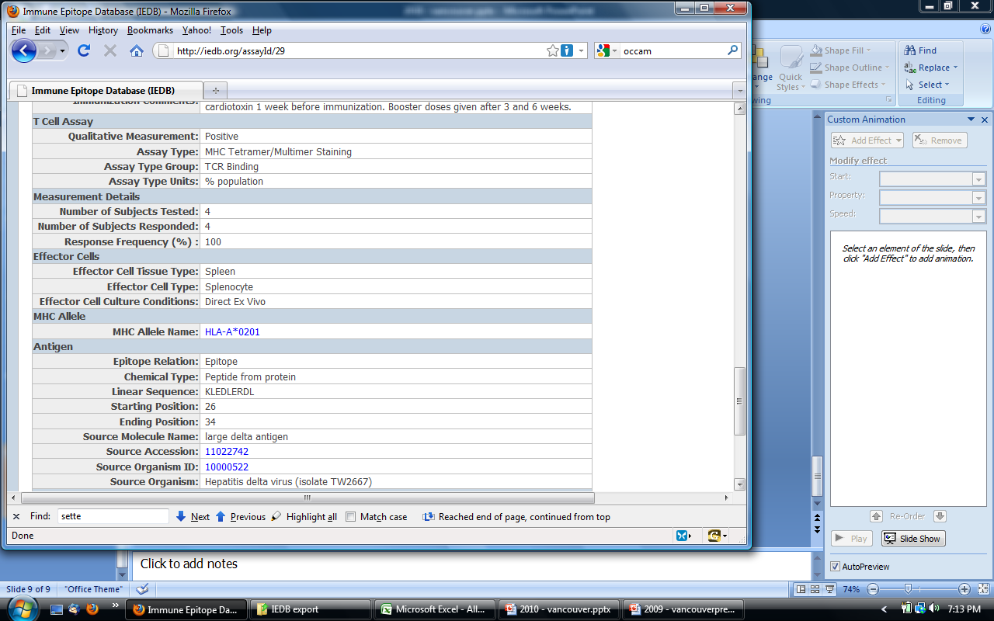
Goal: Represent information in OWL (to allow for reasoning, expressive queries)
by providing export of IEDB into .owl file
This require mapping of DB list values to ontology classes
Current focus: T cell assays

Slide 10
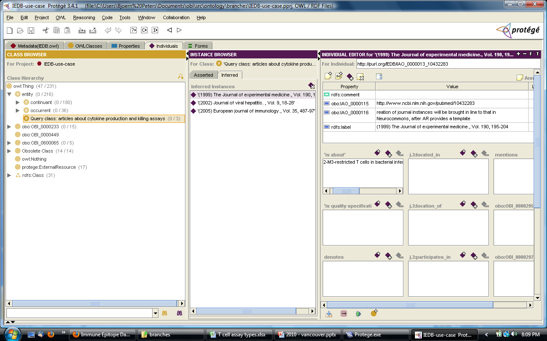
This is all in the paper…

Slide 11
T cell assays
> 125,000 manually curated T cell assays instances
153 entries in the assay table (types)
116 entries after cleanup (merge overlapping entries, remove rarely used entries, remove crap)
31 already in OBI
→ Map (and maintain) all in OBI using QTT

Slide 12
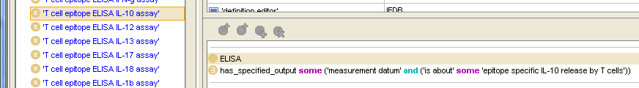
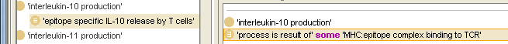
Design pattern
→ Switch to spreadsheet.

Slide 14
Need: ‘efficacy of treatment assays’
two groups of patient with disease X
administer group 1 with drug Y
do nothing with group 2
compare signs & symptoms of disease between groups
conclude ‘treatment’ (2) reduces disease severity
Study design vs. assay plan specification ?
Need to identify ‘treatment’, ‘reference’ (independent variable in ‘intervention design’)
Need assay to evaluate signs & symptoms of disease (dependent variable, assessed by performance of clinical diagnosis)
Specifically: reduction in number of infectious agents (=sign)

Slide 15
in vivo, in vitro
in vivo cell killing assay vs. in vitro cell killing assay
proposal, define ‘in vivo’, ‘in vitro’ in general as types of processes
in live organism assay: an assay in which a measurement is made by observing entities located in an organism. alt-term: in vivo
in live cell assay: an assay in which a measurement is made by observing entities located in a cell. alt-term: some communities: in vivo, other communities in vitro
in container assay: an assay in which a measurement is made by observing entities located in a container

